Slide 1
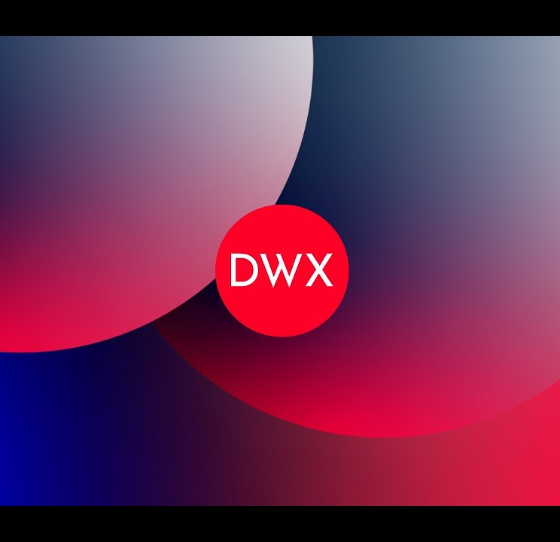
GraphQL
The API for Modern Applications
and
How to build GraphQL APIs in .NET

Slide 2




Arin Roy
Tech Lead, Cloud Native on Azure
Capgemini, The Netherlands
@IamArinRoy
arinroy

Slide 3
AGENDA
Introduction to GraphQL
Query, Type System and Resolvers
GraphQL Gateway and Schema Stitching
Questions

Slide 4
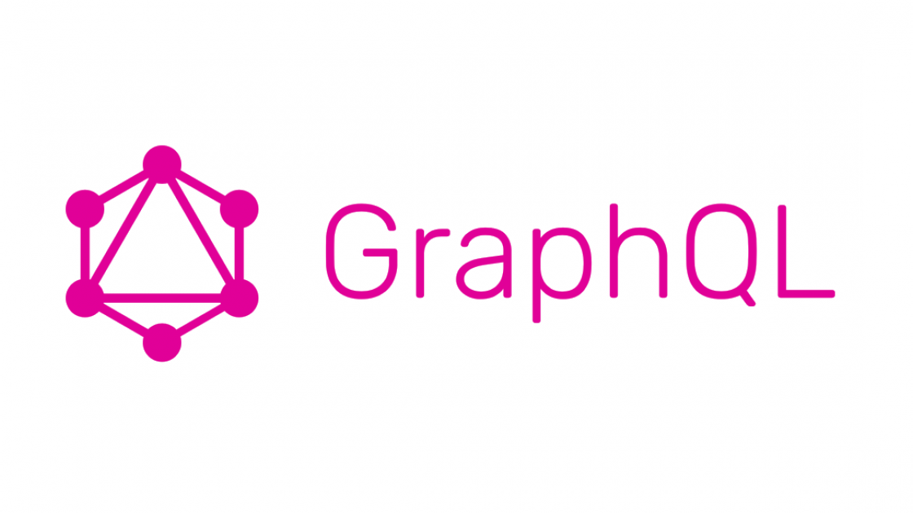

Slide 5
“
The fastest network request is a request not made
”
-- Illya Grigorik

Slide 6
Response times matter
2010: A Mozilla experiment which found that reducing the page load time by 2 seconds led to 15% higher conversion
2011: Gomez reported on 150M pageviews across 150 sites and found that pages that took 6 seconds to load were 25% more likely to be abandoned than pages which loaded in 2 seconds
2016: Google found that increasing the load time of its SERPs by half a second resulted in a 20% higher bounce rate
2016: Google found 53% of mobile visits ended if a page took longer than 3 seconds to load
2017: Akamai aggregated data from 17 retailers (7 billion pageviews) and found that conversion rates were highest for pages that loaded in less than 2 seconds; longer load times correlated with 50% drops in conversion rates and increased bounce rates, especially for mobile visitors
2018: BBC found that for every extra second of page load time, 10% of users will leave
Source: https://www.nngroup.com/articles/the-need-for-speed/

Slide 7
REST
Client
(js, iOS App, Android App etc …)
Public API
/users/1234
3
Profile
http
http
/users/1234/cart
http
/products
http
/products/1/reviews

Slide 8
GraphQL
query {
user{
name
imageUrl
cart
{
numberOfProducts
}
}
products{
name
images
price
reviews{
numberOfStars
}
}
}
Client
(js, iOS App, Android App etc …)
3
Profile
Public GraphQL API
/graphql
http

Slide 9

Over fetching
{
products{
name
images
price
size
inStock
reviews{
author{
name
}
body
numberOfStars
}
}
}
Web
Product
GraphQL
Comments
Mobile
Assets
Social

Slide 10
Under fetching
{
products{
name
images
price
inStock
reviews{
numberOfStars
}
}
}
Web
Product
GraphQL
Comments
Mobile
Assets
Social

Slide 11

GraphQL in Action

Slide 12
Type System, Operations and Resolvers

Slide 13
Type system
Query
Response
Schema
GraphQL is a strongly typed language. Type System defines various data types that can be used in a GraphQL application.
{
product(upc:1){
name
price
}
}
{
"data": {
"product": {
"name": "Shoe",
"price": 899
}
}
}
schema {
query: Query
}
type Product {
upc: Int!
name: String!
price: Int!
size: Int!
images: [String!]!
}
type Query {
products: [Product!]!
topProducts(first: Int!): [Product!]!
product(upc: Int!): Product!
}

Slide 14
Operation types
Query
A query is used to fetch data. It is like requesting a resource in REST-based APIs.
Mutation
Mutations are operations sent to the server to create, update or delete data. These are analogous to the PUT, POST, PATCH and DELETE verbs to call REST-based APIs.
Subscription
Subscriptions allow clients to listen to real-time messages from the server. The client connects to the server with a bi-directional communication channel using WebSocket and sends a subscription query that specifies which event it is interested in. When an event is triggered, the server executes the stored GraphQL query, and the result is sent through the same communication channel back to the client.

Slide 15
Query
Query
Response
A GraphQL query is used to fetch data. It is like requesting a resource in REST-based APIs
To keep it simple, the Query type is the request sent from a client application to the GraphQL server. GraphQL uses the Schema Definition Language (SDL) to define a Query
{
product(upc:1){
name
price
inStock
reviews{
numberOfStars
}
}
}
{
"data": {
"product": {
"name": "Shoe",
"price": 899,
"inStock": true,
"reviews": [
{
"numberOfStars": 5
},
{
"numberOfStars": 1
}
]
}}}

Slide 16
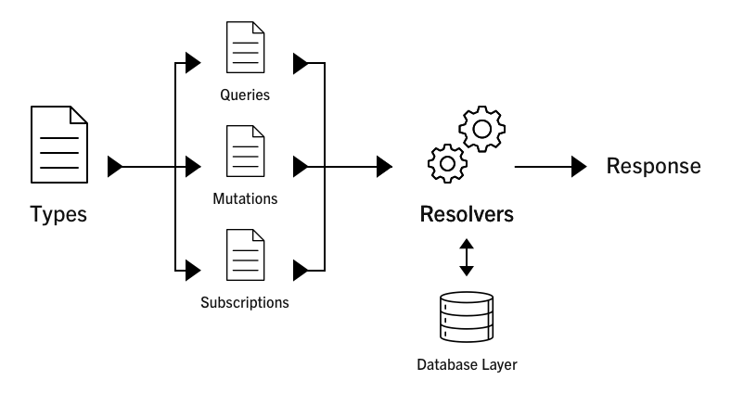
Resolvers
Resolver is a collection of functions that generate response for a GraphQL query. In simple terms, a resolver acts as a GraphQL query handler.

Slide 17
GraphQL and .NET

Slide 18




ChilliCream Platform
Server: Hot Chocolate
Hot Chocolate is a .NET GraphQL platform that can help you build a GraphQL layer over your existing and new infrastructure. You use Hot Chocolate to implement your GraphQL server in .Net
Client: Strawberry Shake
Strawberry Shake is a client tool that generates custom .Net clients for any GraphQL endpoint.
IDE: Banana Cake Pop
Banana Cake Pop is a tool to explore schemas, execute operations and get deep performance insights about any GraphQL server.

Slide 19
Create a GraphQL API from Existing REST API

Slide 20
GraphQL Gateway

Slide 21
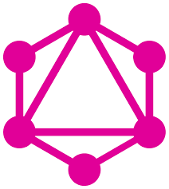
GraphQL Gateway
API
API
Web
API
Gateway
Mobile
API
API
Social
Loads the data the clients needs from GraphQL API
Central arbiter. Stitches backends and caches results
Decoupled GraphQL services describing their own schema

Slide 22
Create a GraphQL Gateway

Slide 23
Key Takeaways
Today it is becoming more and more common to break down a monolithic architecture into small APIs that work independently
The number of endpoints required for clients to fetch the data quickly becomes a challenging approach without impacting performance, complex client integration or draining batteries
GraphQL gives clients the power to ask for exactly what they need – “Exact Fetching” from a single endpoint
The Type System helps to define the schema, which is a contract between client and server and is enforced at runtime
The Gateway can stitch downstream schema’s automatically, providing a single endpoint for clients to get data from multiple downstream microservices

Slide 24

https://graphql.org/
https://chillicream.com/
https://github.com/royarin/Demos/tree/main/2023/DWX/DWXCommerce

Slide 25

